Slide 1

Blackwell Electronic
Buying Trends & Preference Report Kyle Gardner,

Slide 2
OUR PURPOSE
To investigate the patterns in Blackwell’s sale data
Provide insight into customer buying trends and preferences
Identify relationships between customer demographics & purchasing behavior

Slide 3
WE want TO KNOW
about
WHY SHOULD WE BE CARE
Do customers in different regions spend more per transaction?
Does customer’s age differ by region?
Can customer’s age be predicted by region?
Is there a correlation between customer’s age buying preference ?
Are there other factors that predict buying preference?
Is there a relationship between the number of items purchased and amount spent?
Develop and optimize customer database
Improve marketing campaign
Assess product selection
Maximize amount of revenue generated

Slide 4


Customer transaction data
Data Science tools used
10,000 sale transactions collected from in-store and online
Buyer Information collected:
Age
Location
Instore (preference)
Items brought
Amount spent
RapidMiner
Data Mining
Data Processing
Visualization
Scatter
Histogram
Machine Learning
Decision Trees (Algorithm)
Prediction and Classification

Slide 5
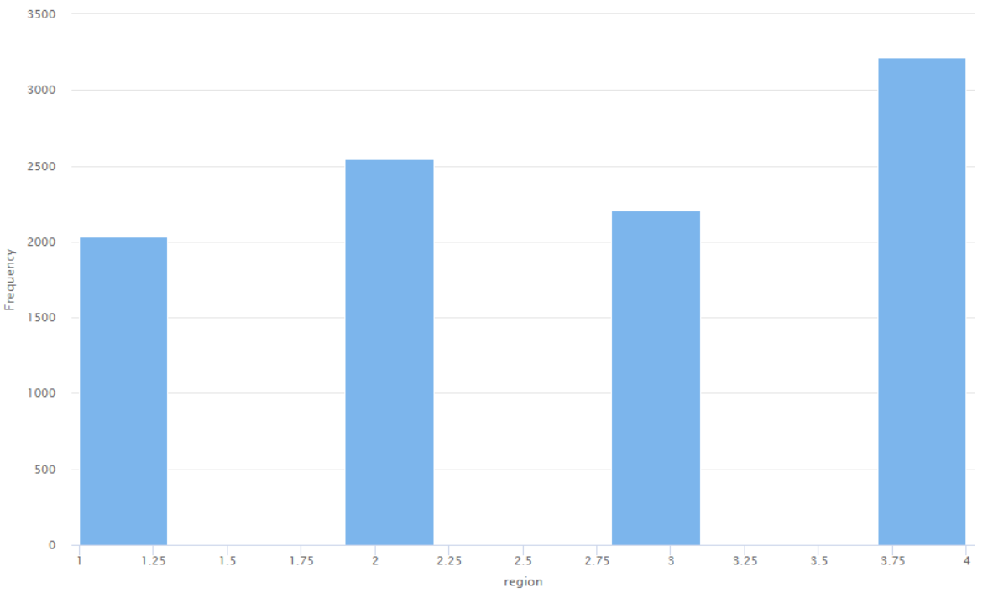
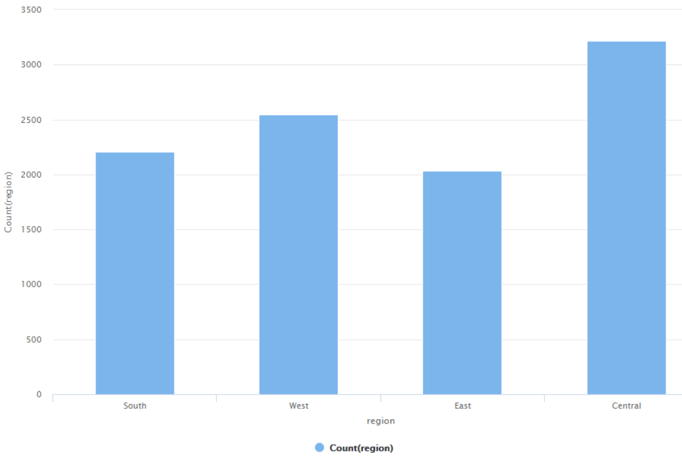
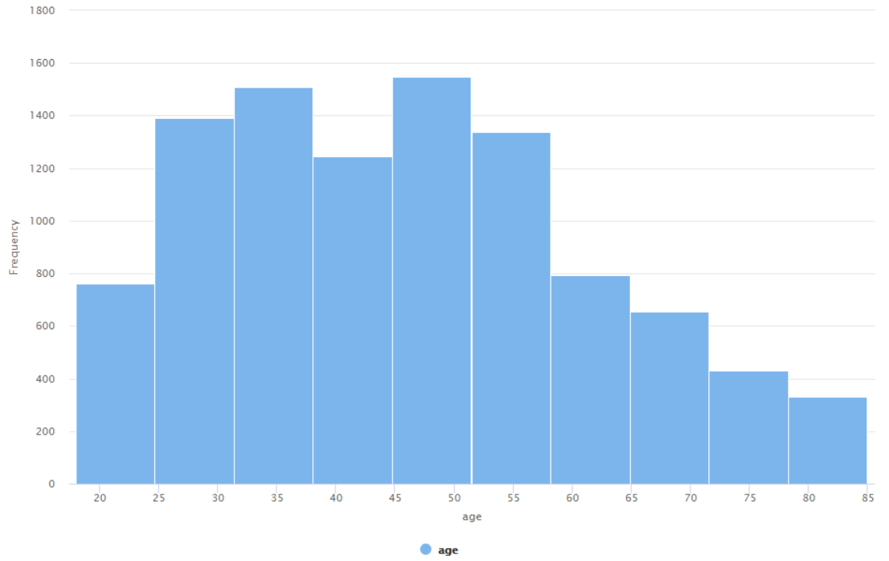
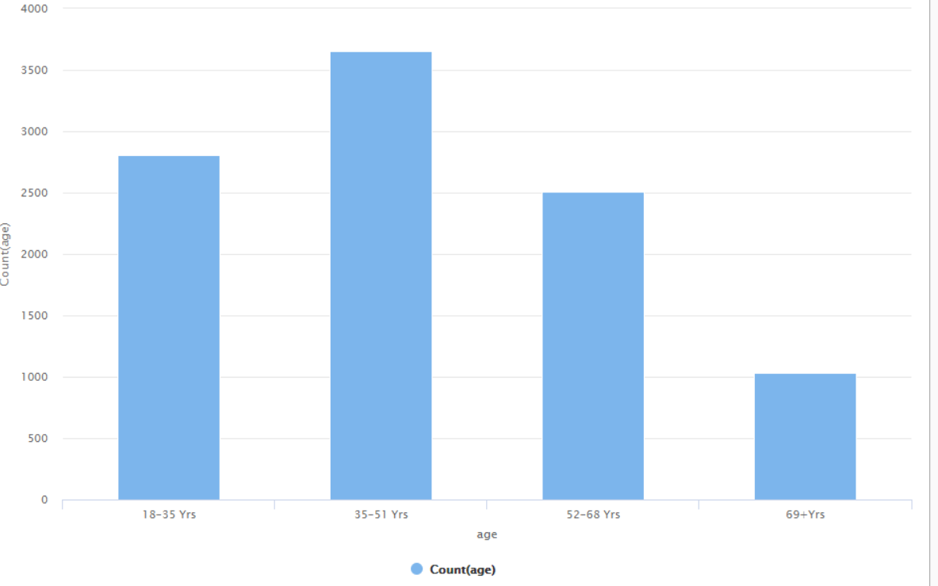
pre-processing problem & solution
Problem 1: Variable type format wrong
Solution: Numeric to Nominal
Region & Instore variables
Problem 2: Value ranges are large and too broad for analysis
Solution: Discretization-Binning
Amount,& Age variables

Slide 6
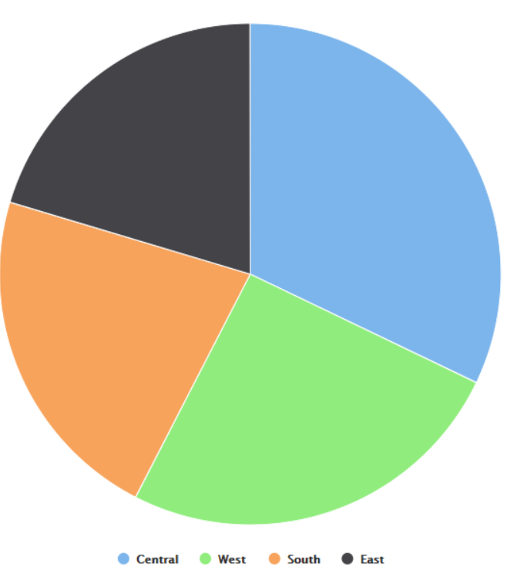
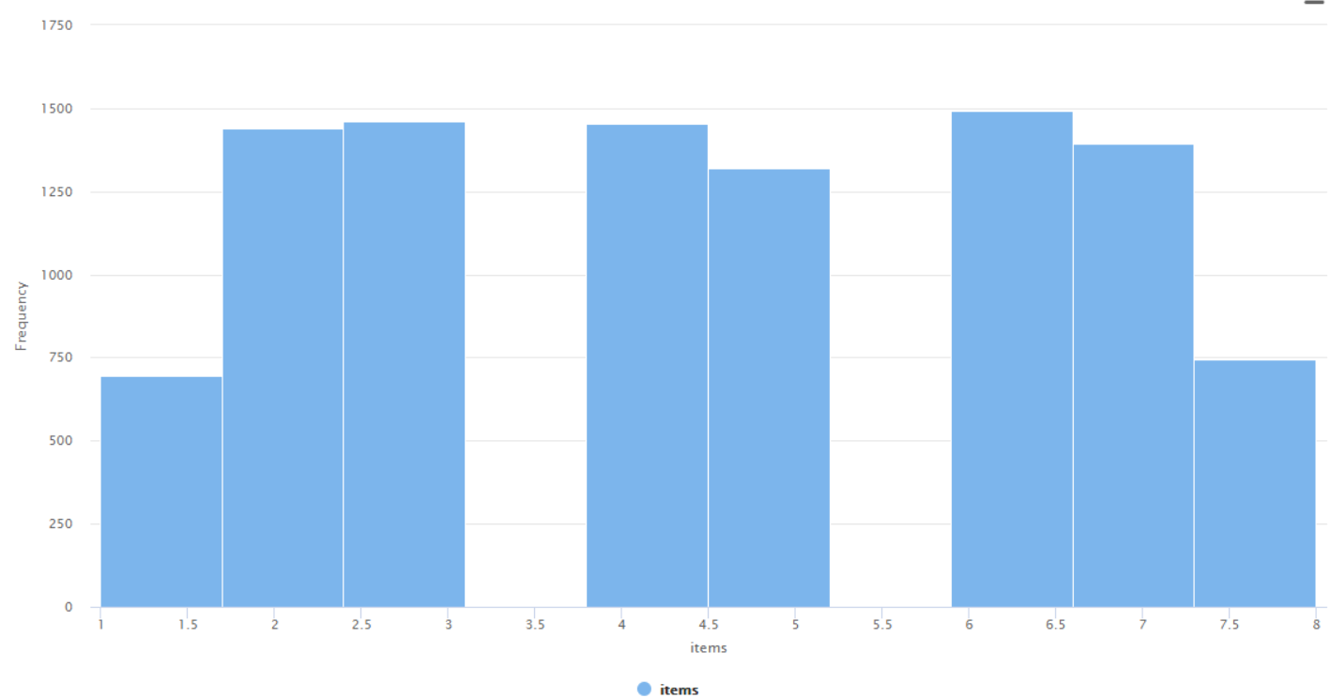
Descriptive statistics of customers
32% reside in Central Region
54% prefer to buy Online
Age range: 18-85 Yrs
Mean: 45 Yrs
Skewed to the left
Amount range:$5-$2,999
Mean: $832
Skewed to the right
Items range:1-8
Mean: 4.5

Slide 7
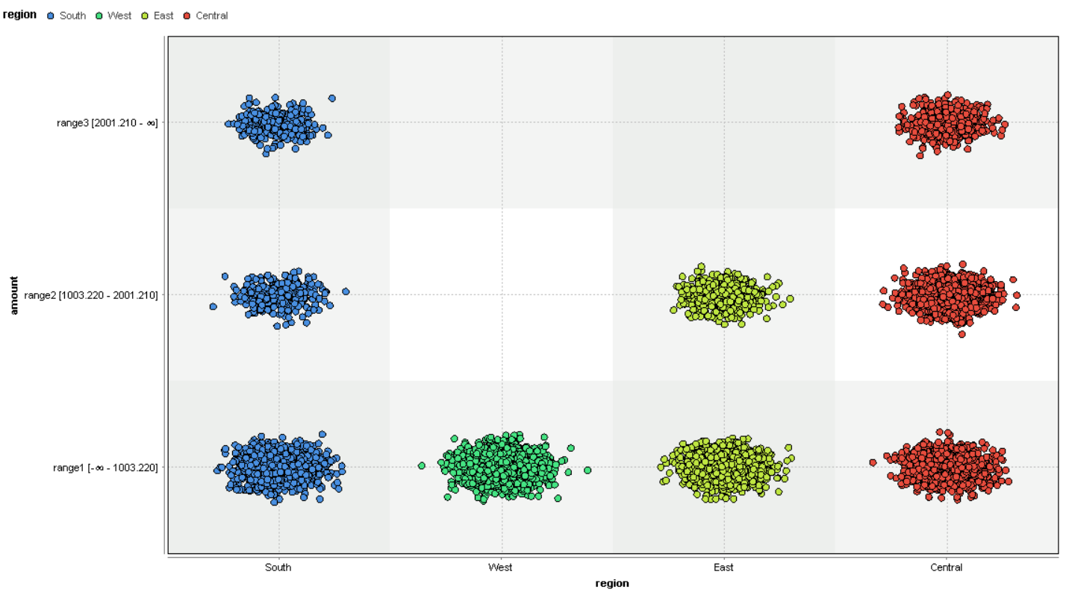
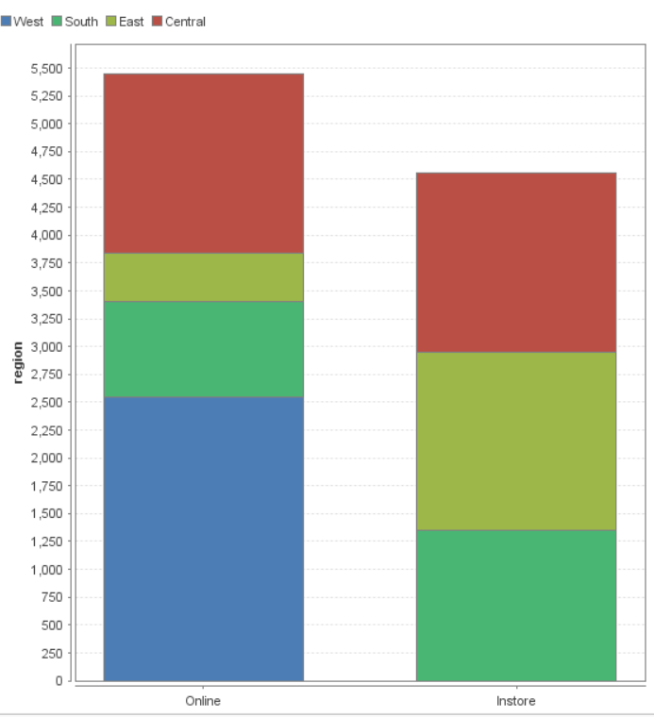
how customers spend and shop
Variation in spending from/ different regions
South & Central spent the most more per transaction
(high amount range $2,001 and up)
East spent the least <$1,003
Should focus marketing campaign in South and Central
Variation in buyer preference from/different regions
West: All sales from online
East & South: Majority of sales from instore
Should investigate why West is not buying in store (location to far)

Slide 8
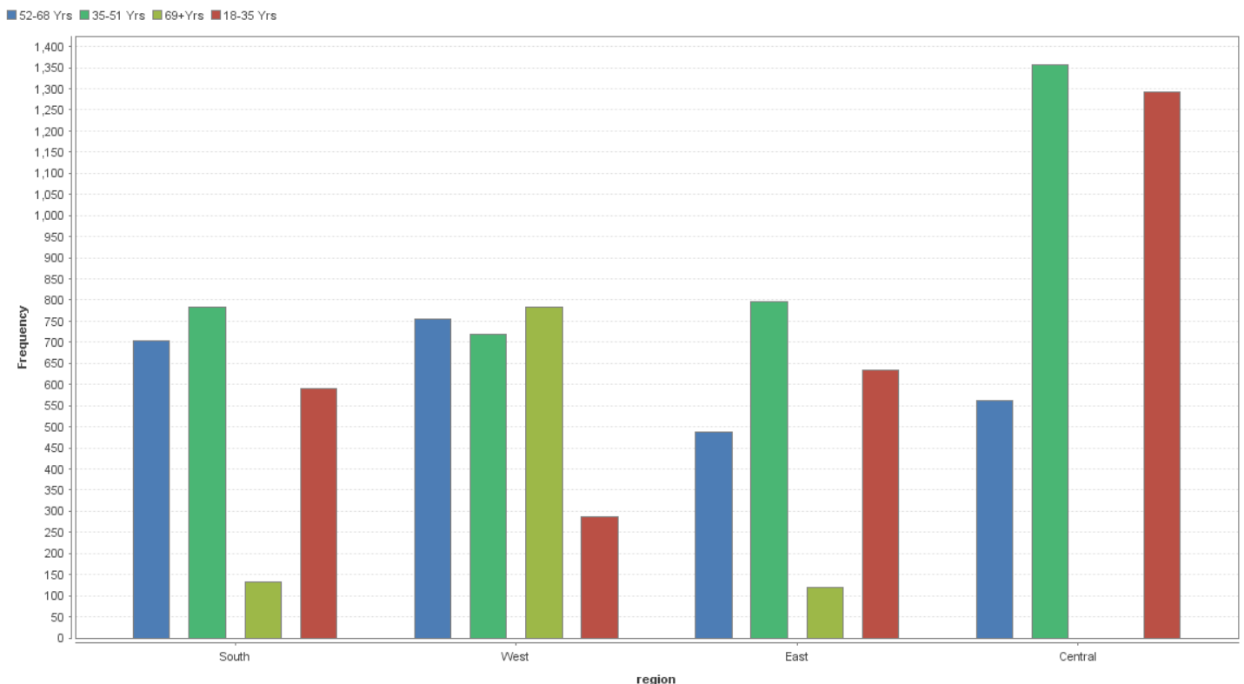
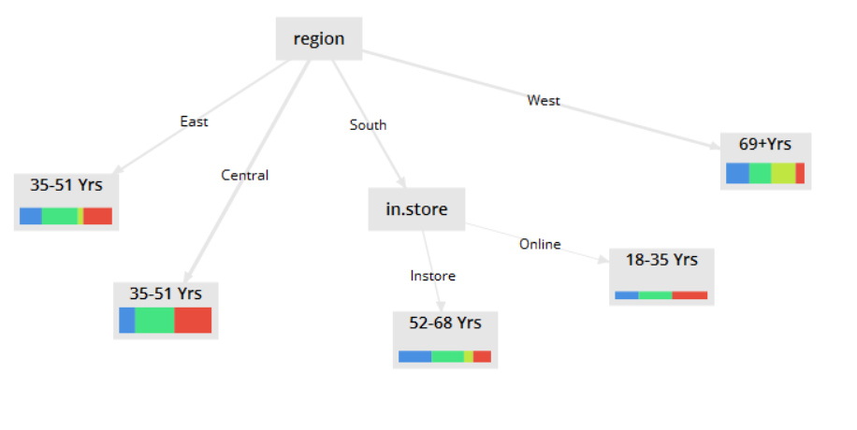
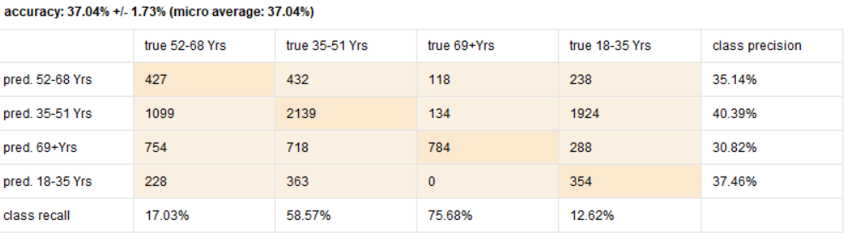
how customers spend and shop
Customer’s age does differs by region
Central
84% were 18-51 Yrs
West
58% were 52-69+ Yrs
Region should not be used to predict age
Decision Tree (Classical)
Overall accuracy of prediction was 37%
Instore was a factor for South region

Slide 9
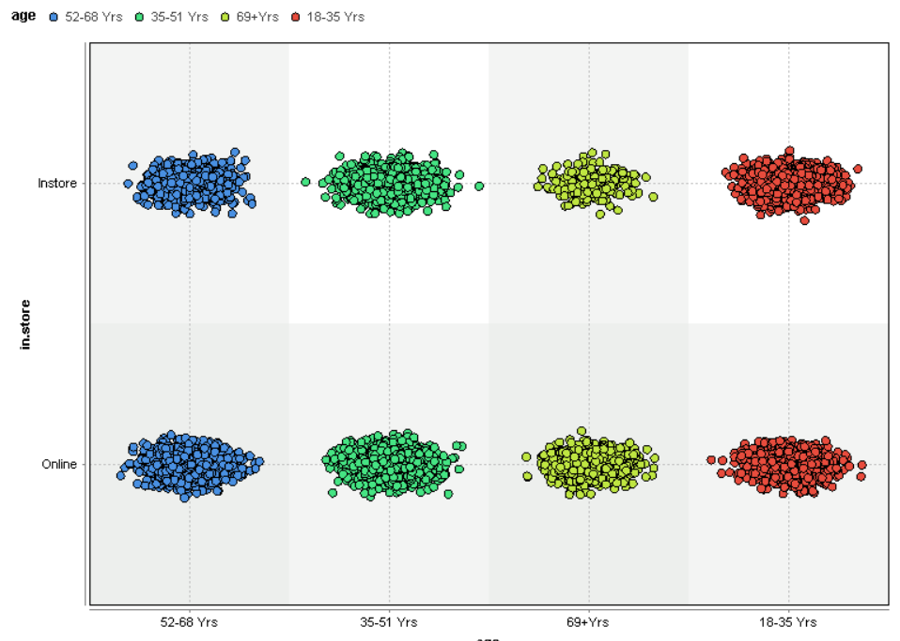
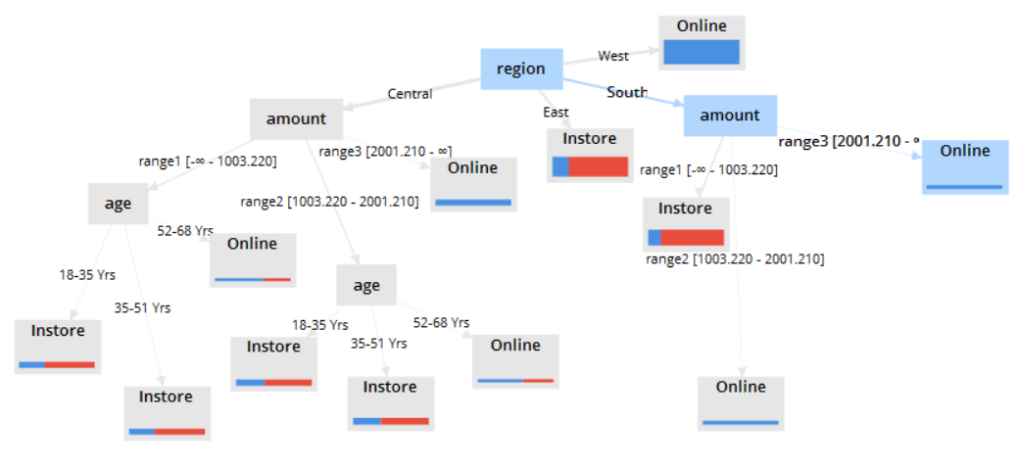
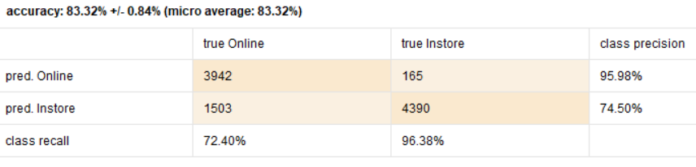
Buying preferences
There is no strong correlation between buying preference and age?
Customers of all ages tend to buy online and instore
However there are variables that can predict buying preferences
Should consider region and then amount
Decision Tree (Classical)
Overall accuracy predicted 83%
Random Forrest
Overall accuracy predicted 85%

Slide 10
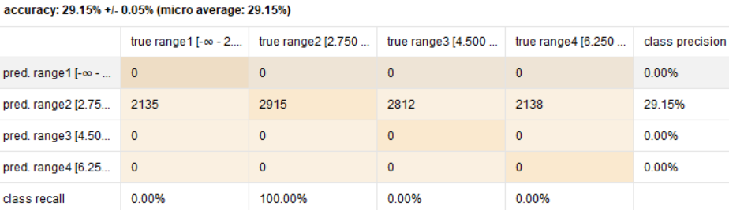
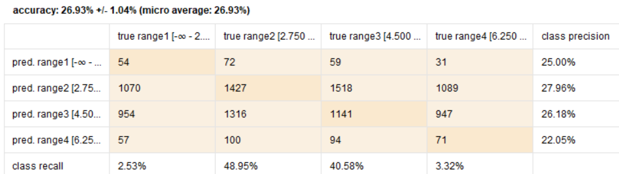
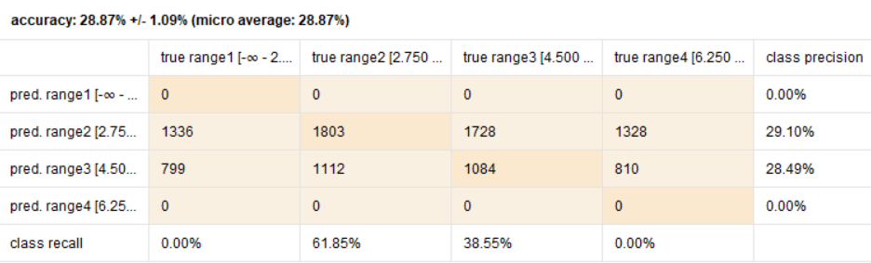
Amount spent and item relationship
The amount spent does not have a relationship on the items
Decision Tree (classical)
Accuracy 29%Poor fit
ID3
Accuracy 26% ; Poor fit
Naives Bayes
Accuracy 28% ; Poor fit

